Slide 1

Investigative tech stock analysis
A quick look at recent stock behaviors of GameStop, Nokia, NVIDIA and Tesla

Slide 2

Which tech stocks to explore?
Four different stocks from the tech industry were chosen for comparison based on different levels of obscurity and different sub-fields within the tech industry. The chosen stocks were GameStop Corp. (‘GME’), Nokia Oyj (‘NOK’), NVIDIA Corporation (‘NVDA’) and Tesla, Inc. (‘TSLA’).

Slide 3

Gamestop corp. (‘GME’)
GameStop Corp. is one of the last surviving brick-and-mortar chains selling video games and video game consoles, usually at affordable, used prices.
GameStop has had an interesting recent history in the stock market. In late 2020, hedge fund investors spent a significant amount, seeking to short the GME stock. In January 2021, Reddit users rallied together to save GameStop’s stock, resulting in the stock value skyrocketing to over $340 per share when it had been only $4 per share less than a year prior. The hedge fund investors ended up losing over $12B.

Slide 4

Nokia oyj (‘nok’)
Nokia is a Finnish corporation, primarily known for their mobile phone popularity a couple of decades ago. Nokia is now a major manufacturer of network equipment. They have also acquired Alcatel-Lucent, whose research organization, Bell Labs, has a rich history in technological innovation over the past century. Bell Labs has contributed programming languages, accessible telecommunications, lasers and optical fiber.

Slide 5

NVIDIA corporation (‘NVDA’)
NVIDIA creates components for computers and is particularly known for their graphics cards, which they both design and develop. They also produce CPUs (central processing units).

Slide 6

Tesla inc. (‘TSLA’)
Tesla is an automotive company founded shortly after the turn of the century. Tesla is known for its electric vehicles and cutting-edge technology. Tesla’s CEO, Elon Musk, is regularly featured in global news, partly because he is the richest man in the world. He is a controversial figure in the world of technology and politics.
Tesla vehicles have mixed reviews as innovative cars are produced but concerns arise about safety as news articles claim self-driving cars cause accidents.

Slide 7
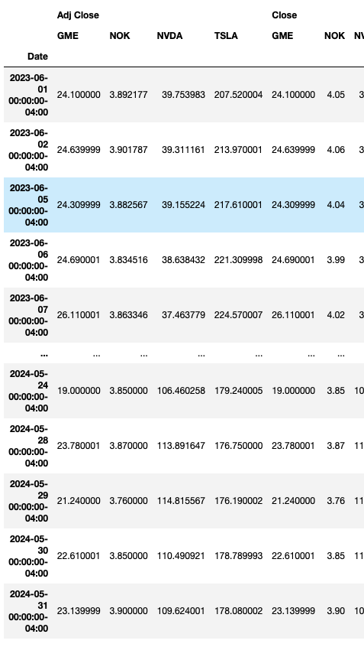
Stock comparisons
These four stocks (‘GME’, ’NOK’, ‘NVDA’ and ‘TSLA’) were compared from June 1, 2023 to June 1, 2024.
For the purposes of this presentation, we will review adjusted closing prices, average rate of returns, standard deviations, covariances and recommended portfolios based on this information.

Slide 8
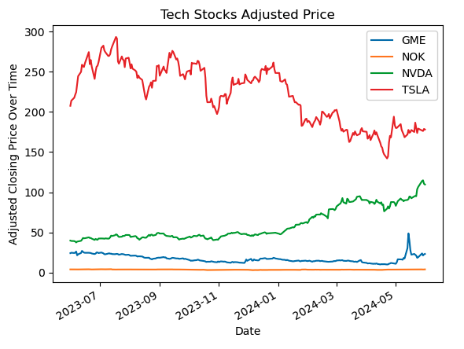
Adjusted closing prices
The first feature that was reviewed was each stock’s closing price over the past year. The following chart illustrates adjusted closing prices.
At first glance, we see that the value of TSLA stock is significantly higher than the others, but also far more volatile. Comparatively, Nokia is stable, but worth very little.

Slide 9
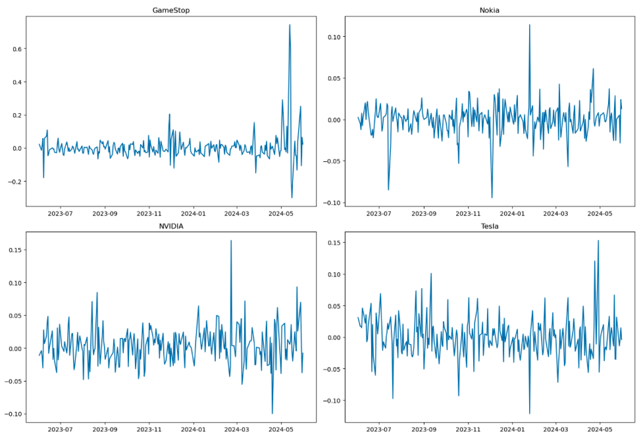
Daily rates of return
These graphs chart daily rates of return for each of the four stocks. It is evident, that especially recently, GameStop had significant changes ranging from .6% increase to a -.3% decrease. Nokia’s returns were more stable with its highest increase being .1% and its lowest decrease being -.1%.

Slide 10
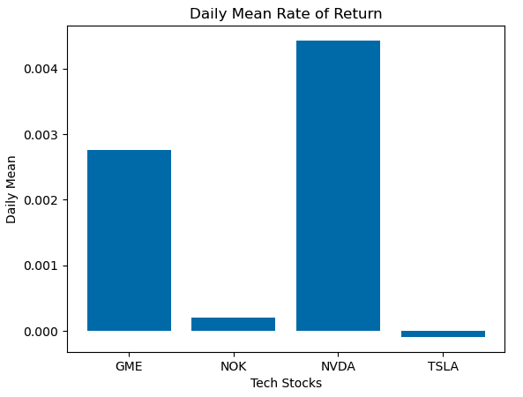
Average rates of return
This next chart compares each stock’s average rates of return over the past year. As evidenced here, GME is high in spite of its recent volatility, NVDA is the most profitable and TSLA has a negative rate of return.
The actual percentages are as follows: GME (.28%), NOK (0.02%), NVDA (0.44%) and TSLA (-0.01%).

Slide 11
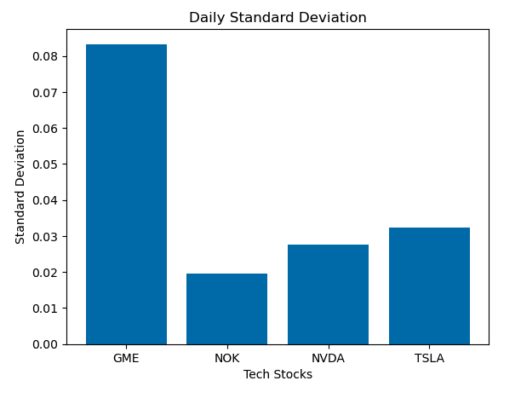
Standard deviation
How does the standard deviation compare with each stock?
Upon analysis, it is evident that GME is significantly more volatile than the other three stocks at 8% standard deviation. However, all of the stocks can be considered relatively predictable.

Slide 12
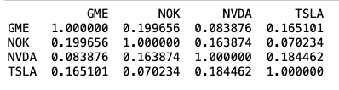
Stock correlation
The correlation of each stock to each of the other stocks reveals whether one stock changing is likely to change other stocks. This chart shows the relationships between the chosen stocks. A value of 1 indicates the stocks are very likely to be closely affected in the same way while a value of 0 indicates that the stocks are not likely to be affected at the same time.
For example, NOK and TSLA appear to be completely unrelated in the stock market while a change in GME may also slightly affect NOK in a similar way.

Slide 13

Portfolio recommendations
Based on this previous information, here are some stock portfolio recommendations based on $5,000:
Invest all $5,000 in NVDA. This has the highest expected return at .44% with only 2.8% volatility.
Invest $3,500 in NVDA, $1,000 in NOK and $500 in GME. This would result in an expected return of 0.33% with 3% volatilility.
Invest $2,500 each in NVDA and NOK. This has a lower return of .23%, but only 2.4% volatility.
Invest $2,500 in NVDA, $1,000 in NOK, $1,000 in TSLA and $500 in GME. This portfolio has an expected return of 0.24% with a 3.3% volatility rate. This portfolio has the highest risk with one of the lowest expected returns.

Slide 14
Final analysis and recommendations
Based on this overall analysis, it is not recommend to invest in TSLA at this time. Its expected return is minimal.
On the other hand, it is recommended to invest in NVDA. Its rate of return is relatively high and it is a stable stock.
GME is positive right now with a decent rate of return, but its volatility is not as stable as NVDA or NOK.
NOK is the most stable of the four stocks, but its rate of return is low. It is recommended to invest in nokia if stability is the most important factor.

